Slide 1
NYU-6463 PROCESSOR
TEAM MEMBERS
Amit Mohan Redkar (amr1006)
Anant Raghavendra Choudhari(ac6413)
Hrishikesh Garai(hg1230)
Raj Chetan Mehta (rcm445)

Slide 2
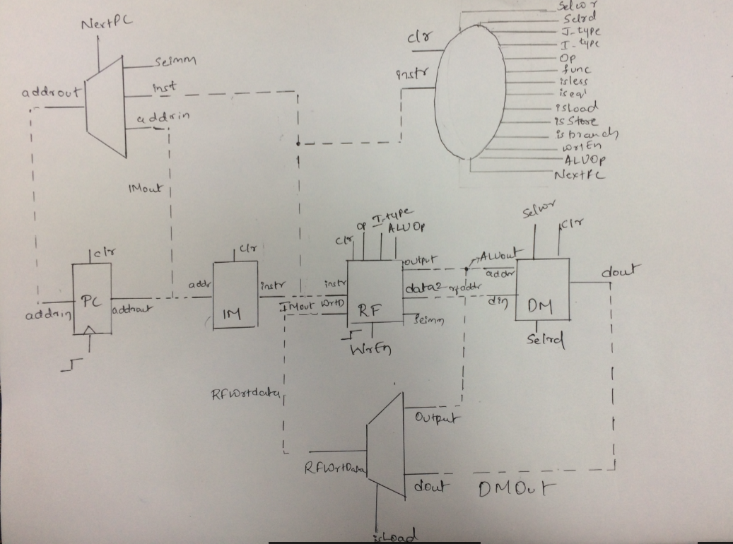
Processor Design

Slide 3
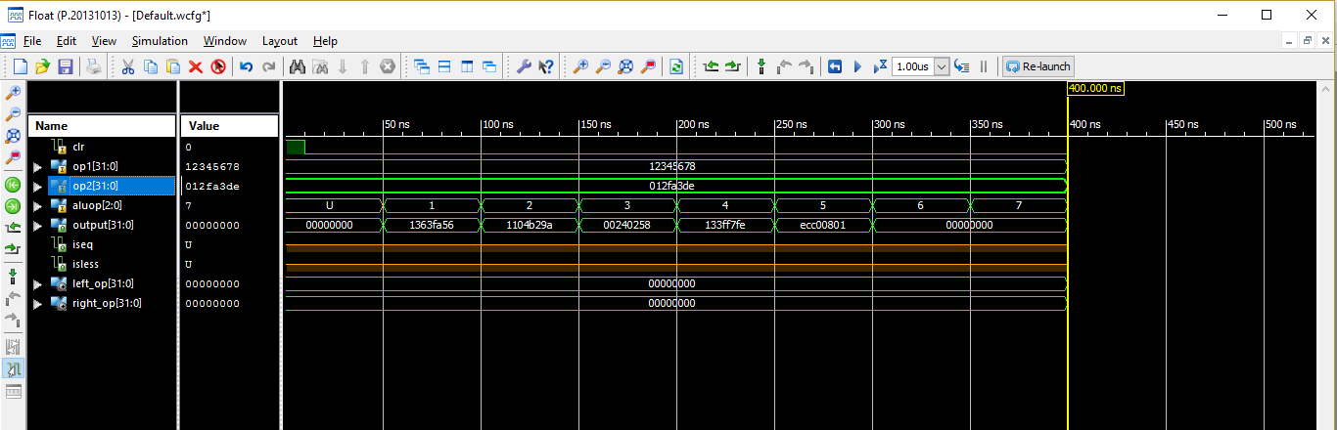
ALU Functional Simulation

Slide 4
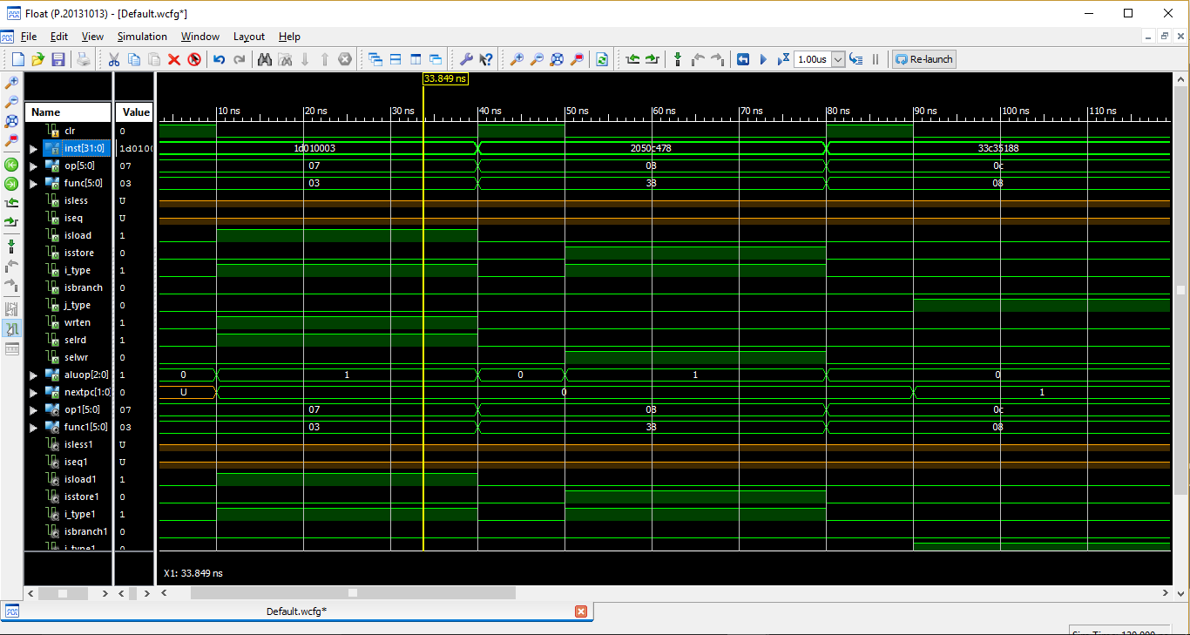
Decoder Functional Simulation

Slide 5
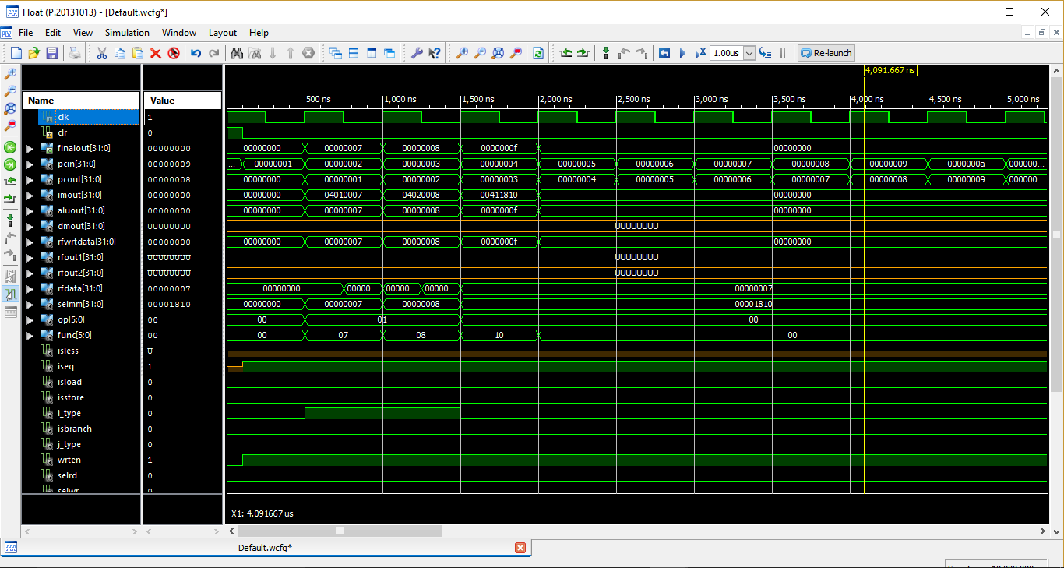
Sample Code 1- Functional Simulation

Slide 6
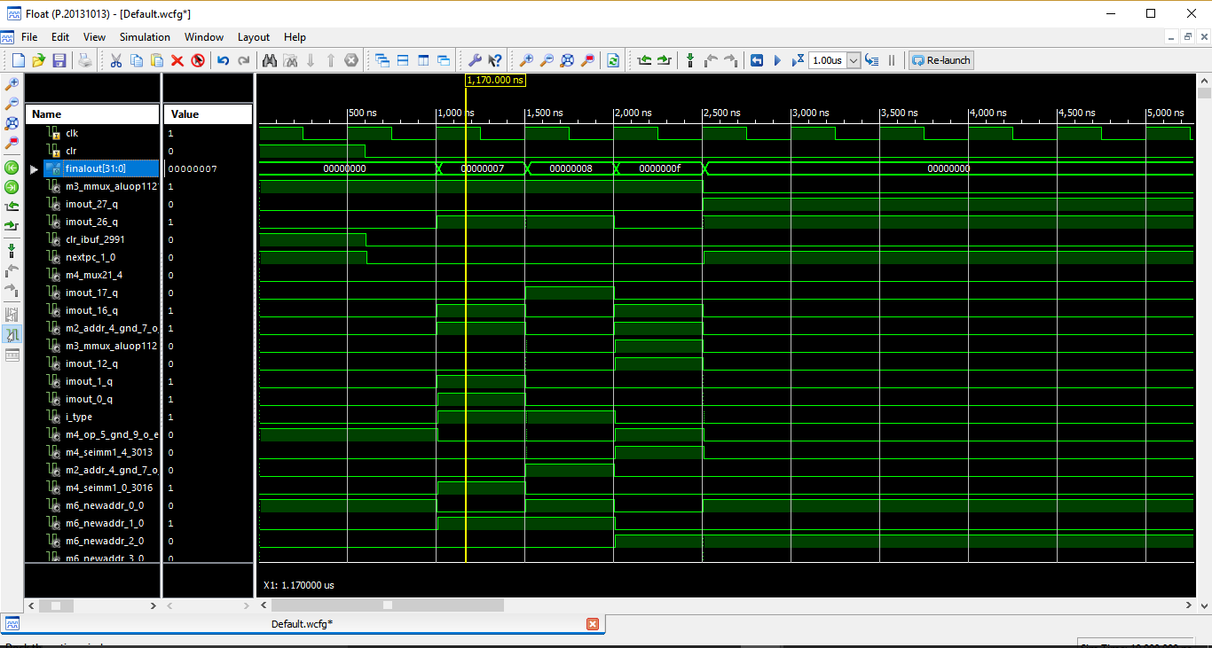
Sample Code – Timing Simulation

